Slide 1

DetectiveMask
An AI application for
mask detection
Group 26 (3Musketeers):
Hong Xiaohui, SXXXX943D, imhongxiaohui@gmail.com
Anita Koo Shi Qi, SXXXX480B, anita.koo@ncs.com.sg
Sanjeven Ramakrishnan, SXXXX938E, sanjeven.ramakishnan@ncs.com.sg

Slide 2
TABLE OF CONTENTS
01.
02.
03.
04.
Objectives
Data Source
The goals of our project
The details of the data resources required/available
Technology
Progress
Techniques/tools used
Simple demo for current progress

Slide 3
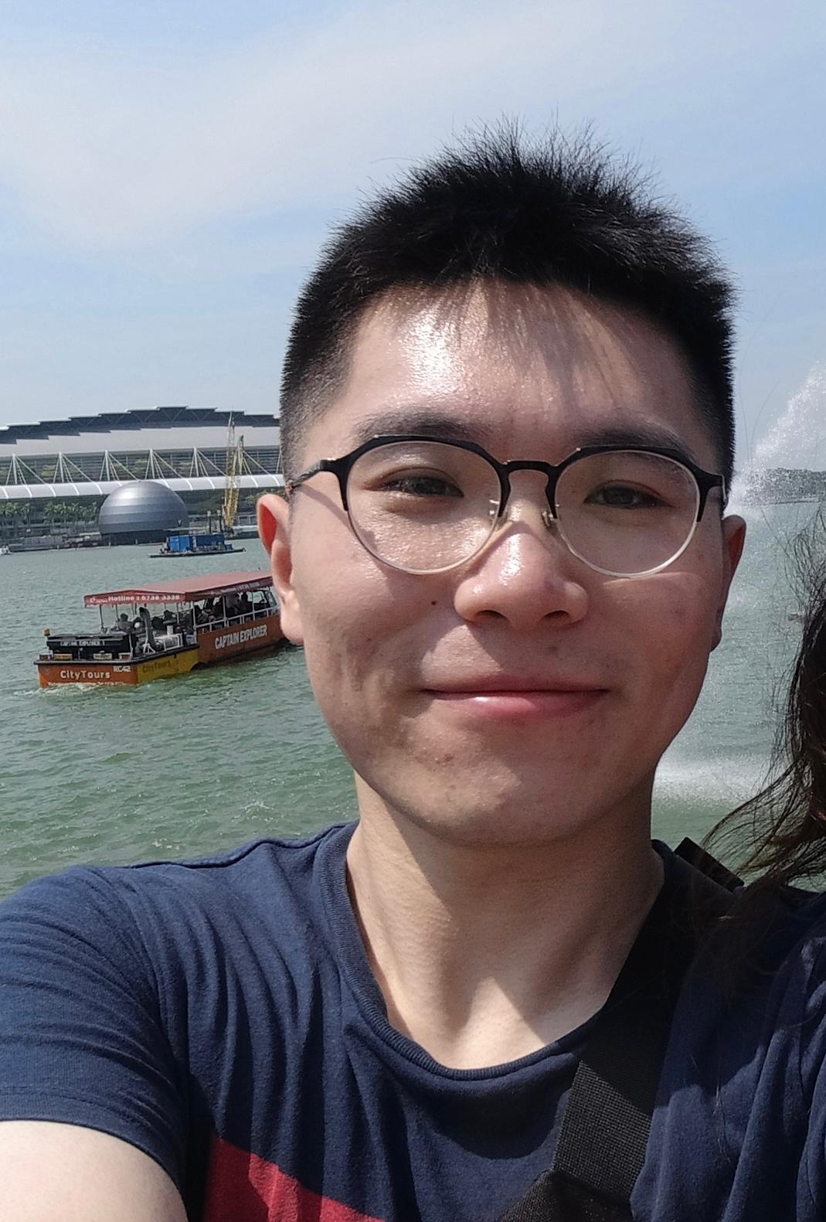
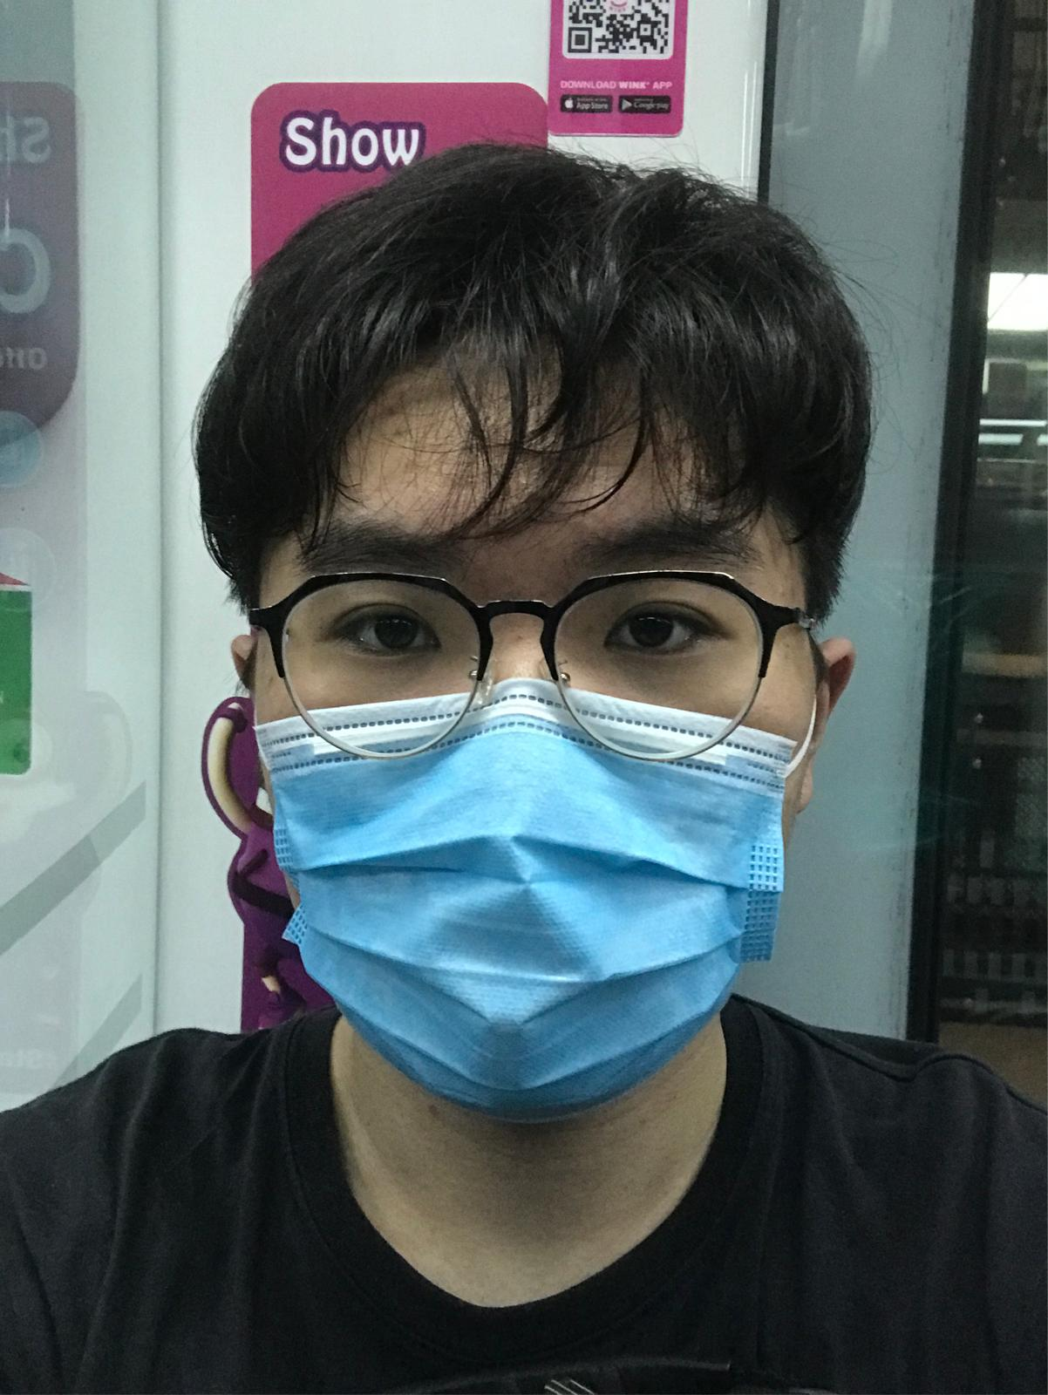
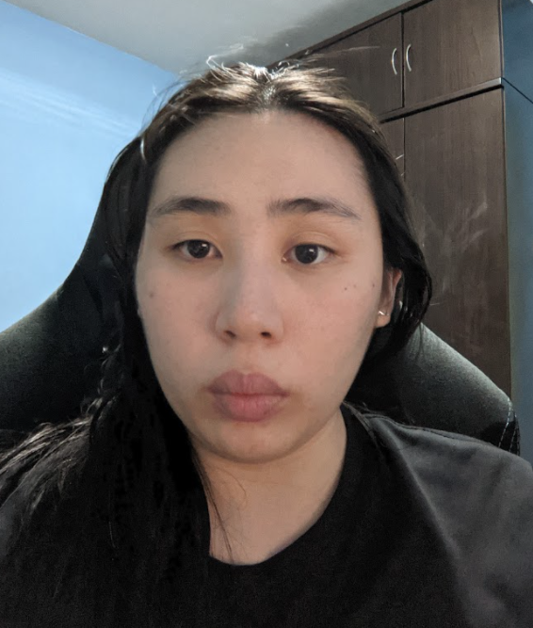
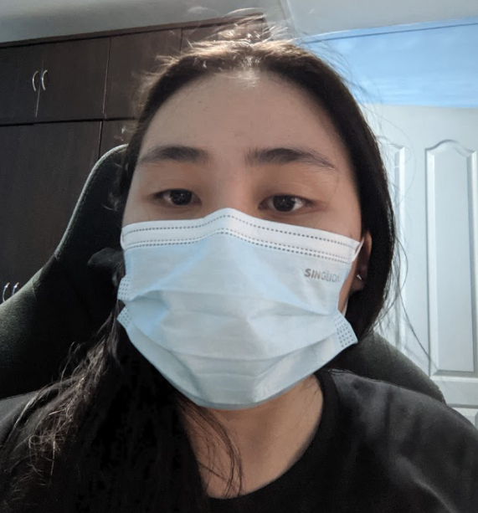
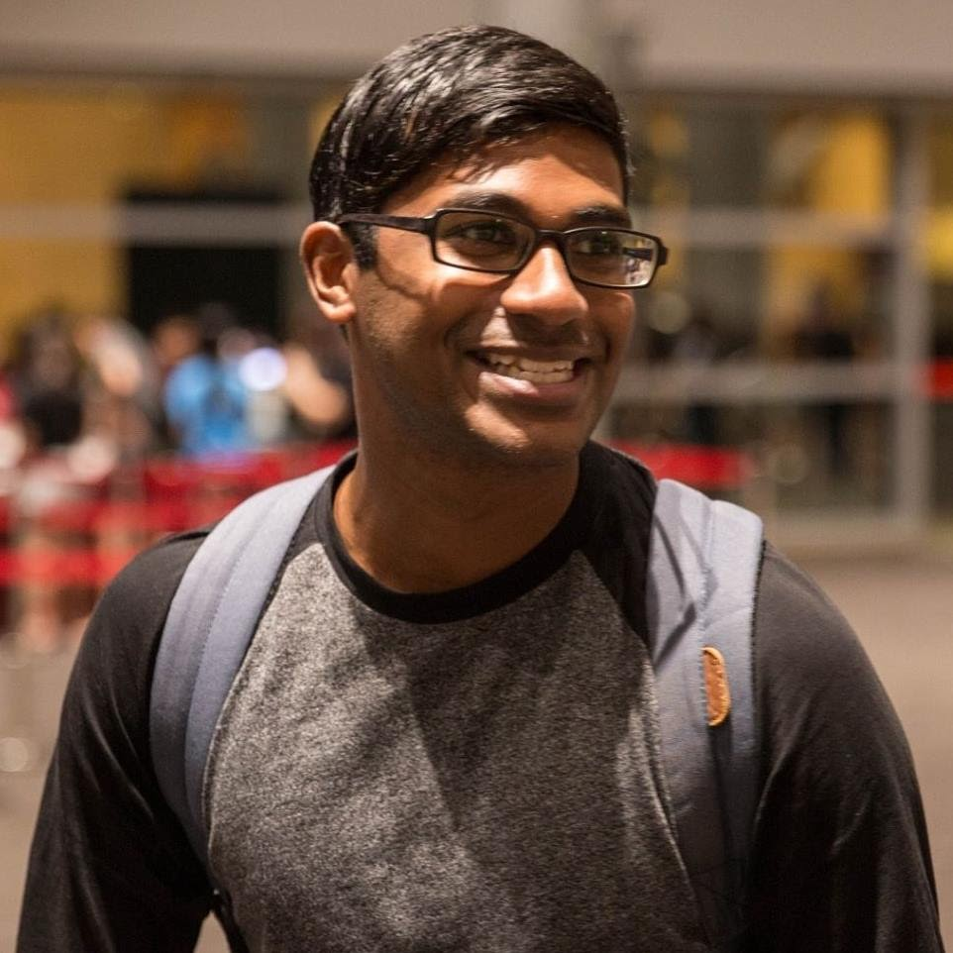
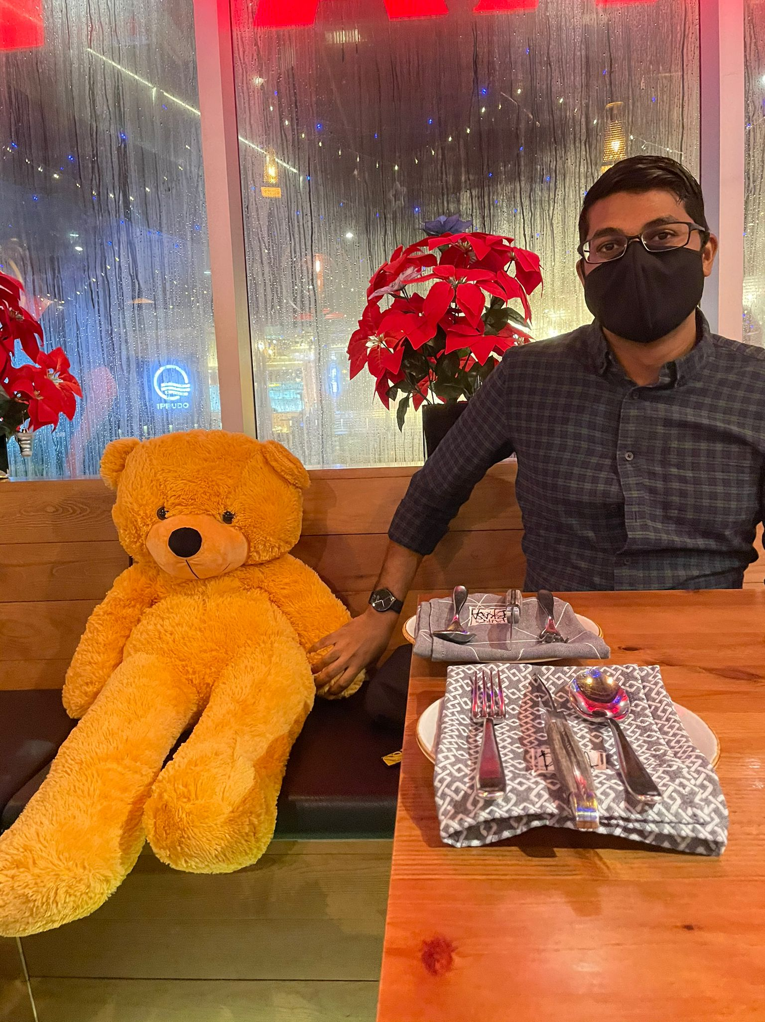
OUR TEAM
Without Mask
With Mask
Without Mask
With Mask
Without Mask
With Mask
Hong Xiaohui
Anita Koo Shi Qi
Sanjeven Ramakrishnan
SXXXX943D
imhongxiaohui@gmail.com
SXXXX480B
anita.koo@ncs.com.sg
SXXXX938E
sanjeven.ramakishnan@ncs.com.sg

Slide 4
OBJECTIVE
To create an application to aid health enforcement officials to carry out their duty by providing notifications and alerts when a breach is detected

Slide 5
BENEFITS OF OUR SOLUTION
STREAMLINE
MANPOWER
Can be redeployed to serve our community better
Streamline the process of detecting people who do not comply with regulations
SWIFT ACTION
VERSATILE
System can be deployed in different scenarios
Allows authorities to take swift action to kerb the spread of the virus

Slide 6
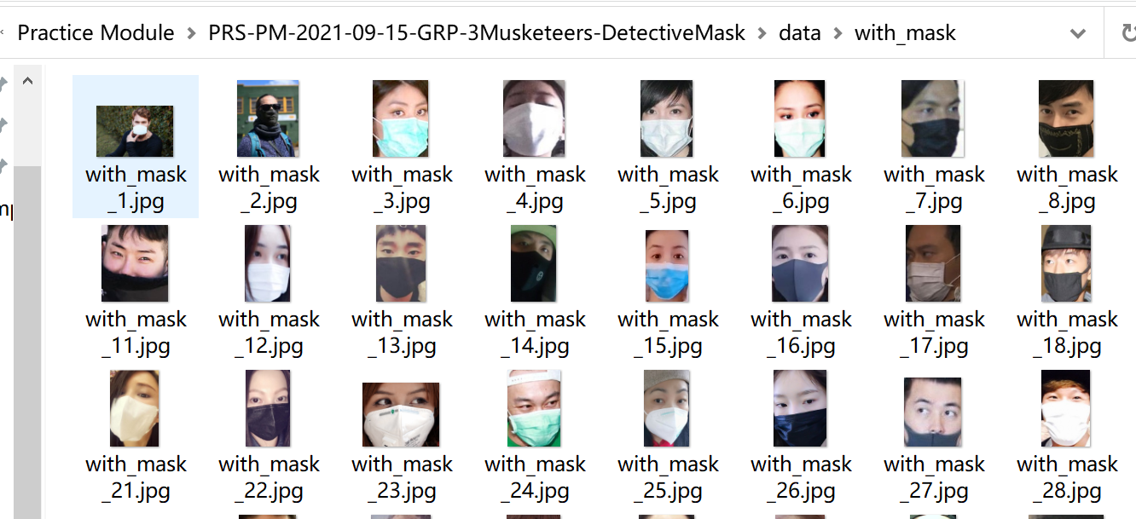
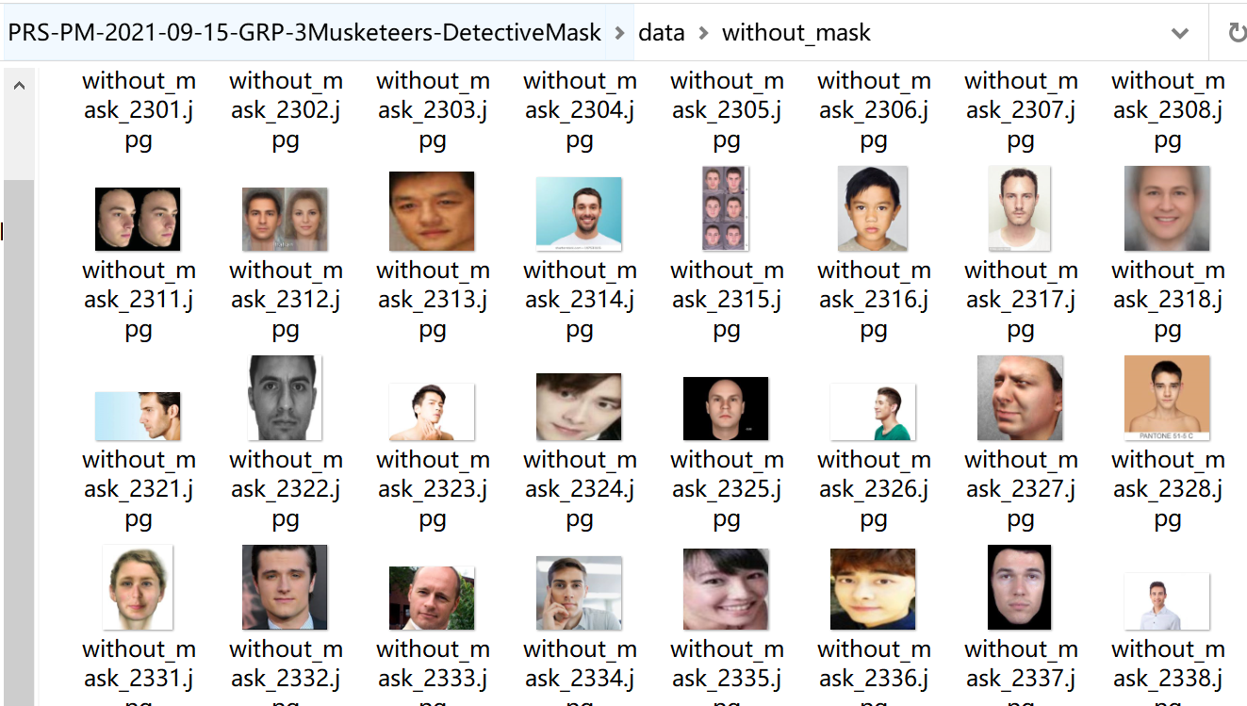
DATA SOURCE
Data set consists of 7553 RGB images in 2 folders as withmask and withoutmask.
Images are named as label with_mask and without_mask.
Images of faces with mask are 3725 and images of faces without mask are 3828.
https://www.kaggle.com/omkargurav/face-mask-dataset

Slide 7
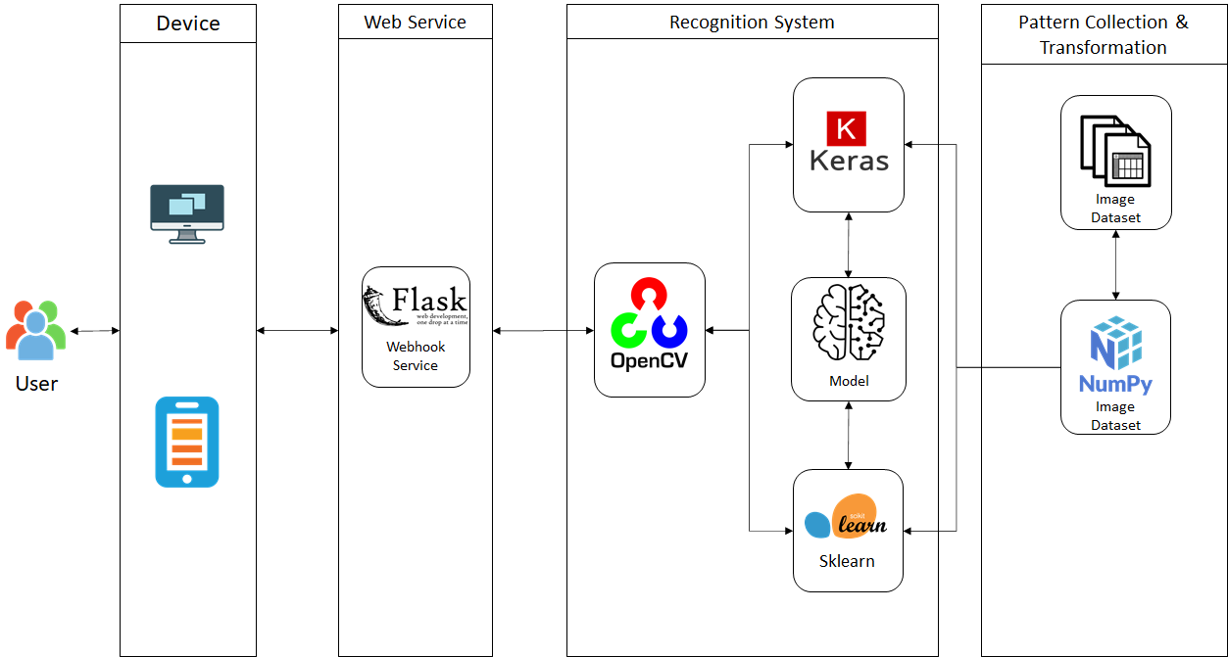
TECHNOLOGY
Algorithms: KNN, SVM and CNN

Slide 8
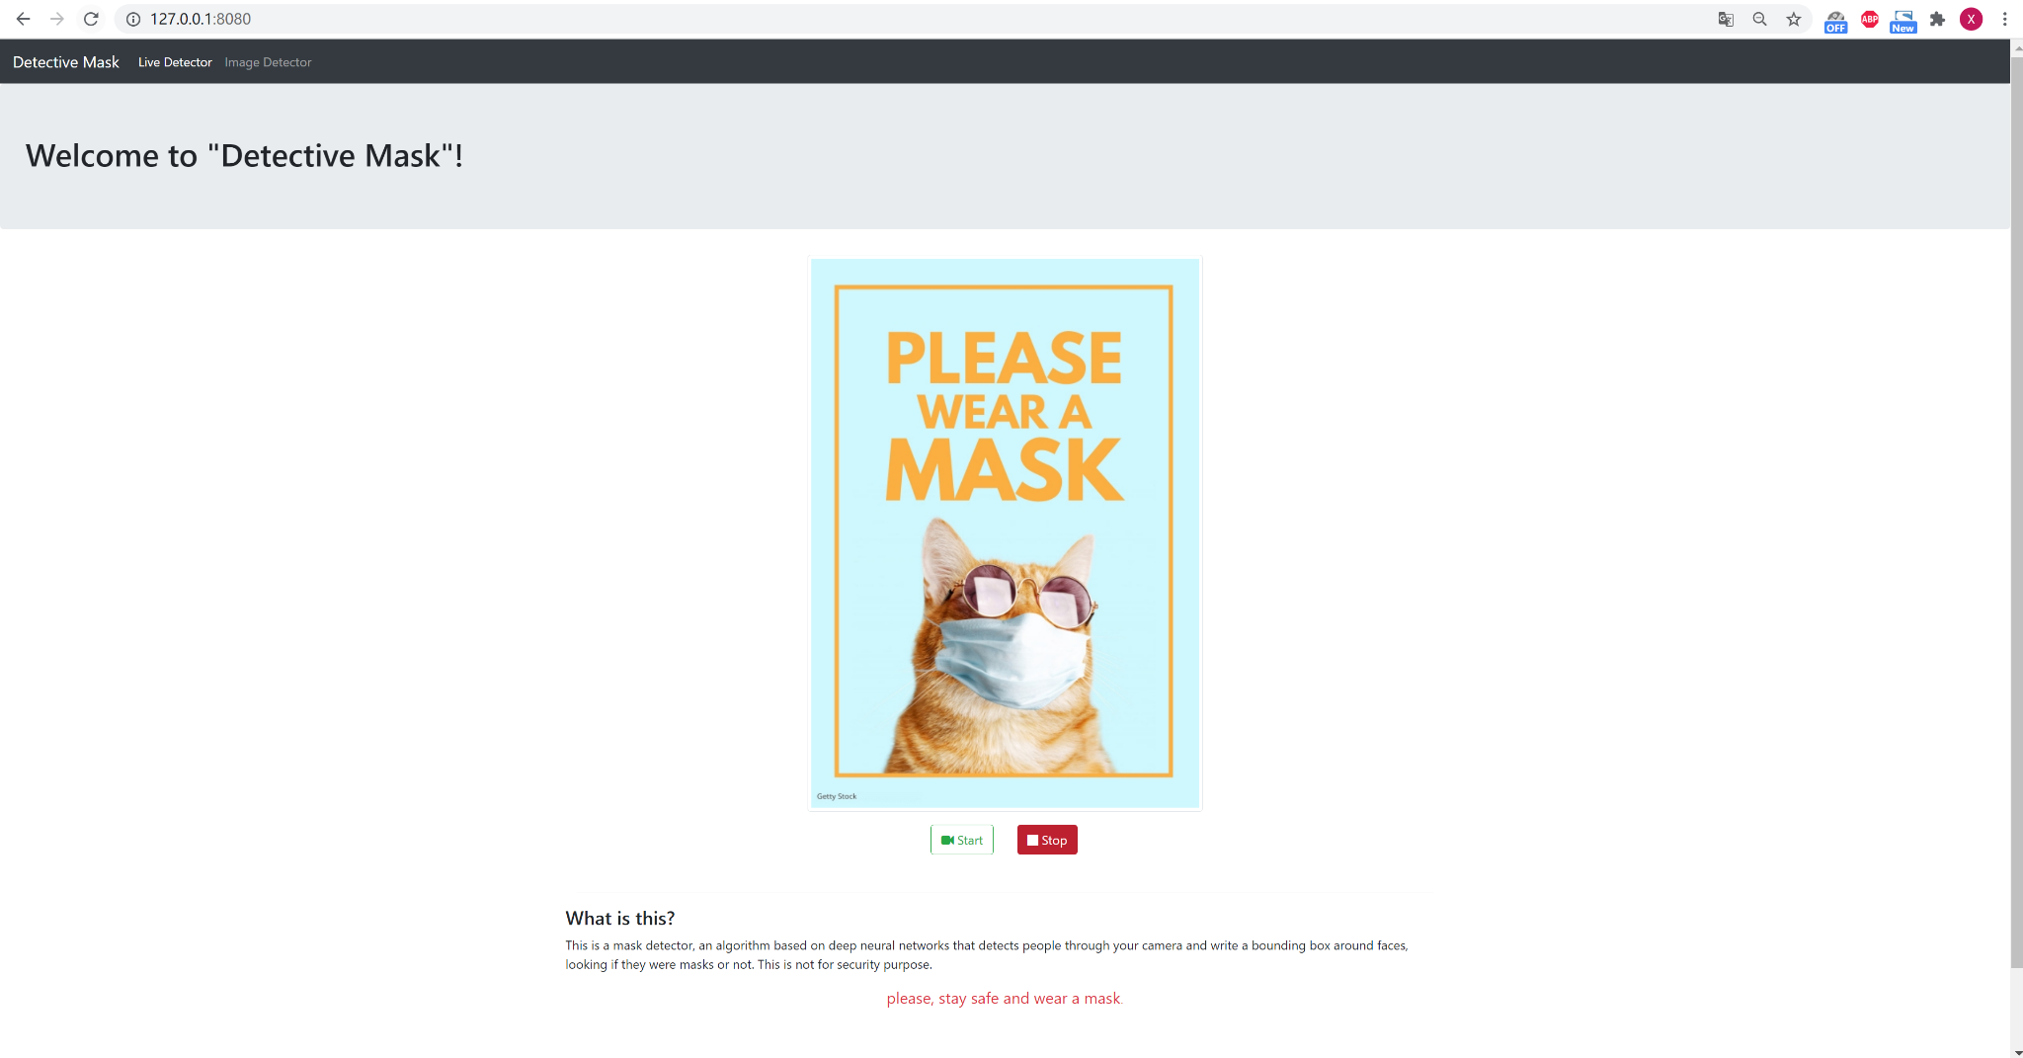
PROGRESS
Notes:
Demonstrate the current progress of our application and model creation.

Slide 9
Q&A

Slide 10
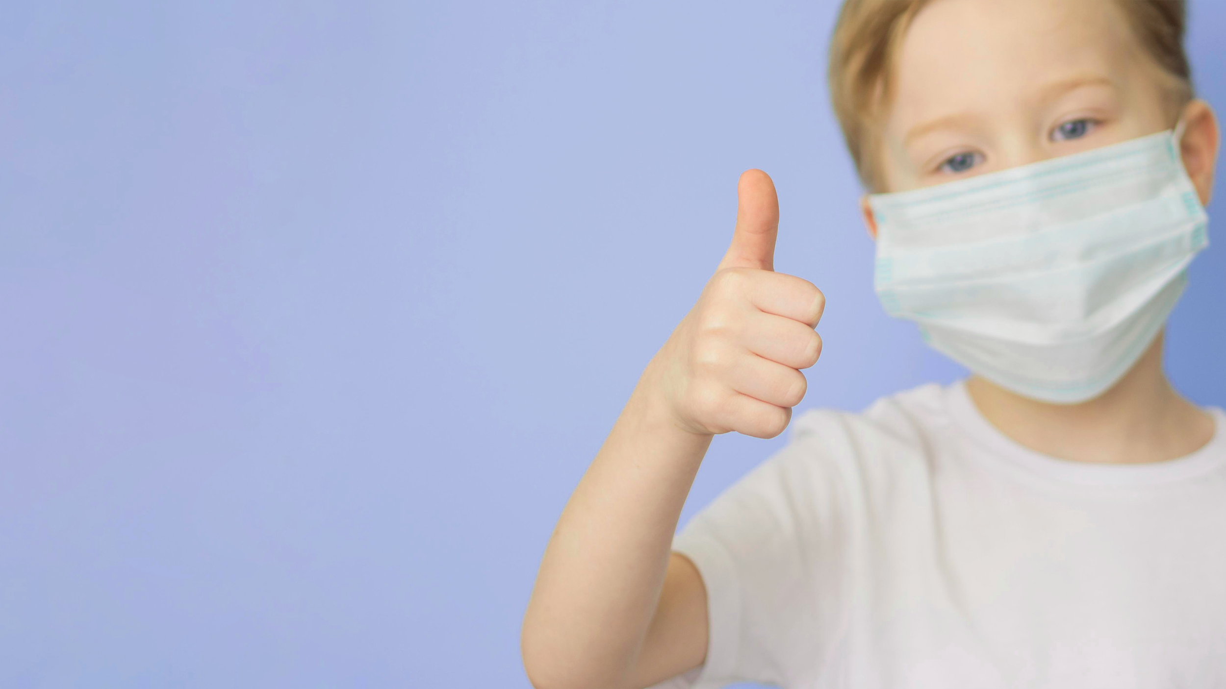
THANKS!
PLEASE REMEMBER TO WEAR A MASK AND STAY SAFE!

